Slide 1
Name- MD Gulzar
Registration No.-12405924
Roll No.-RK24DJB59
Section-K24DJ

Slide 2
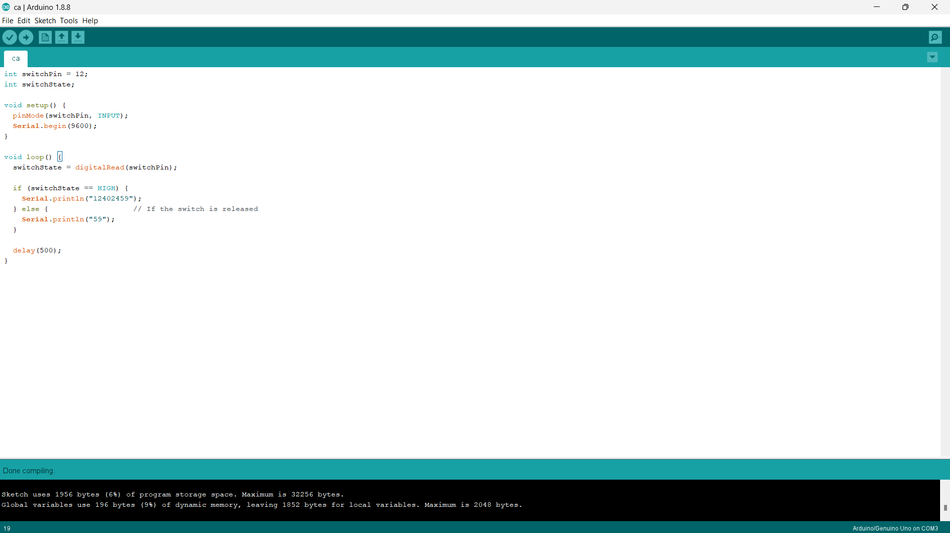
Question no 1

Slide 3
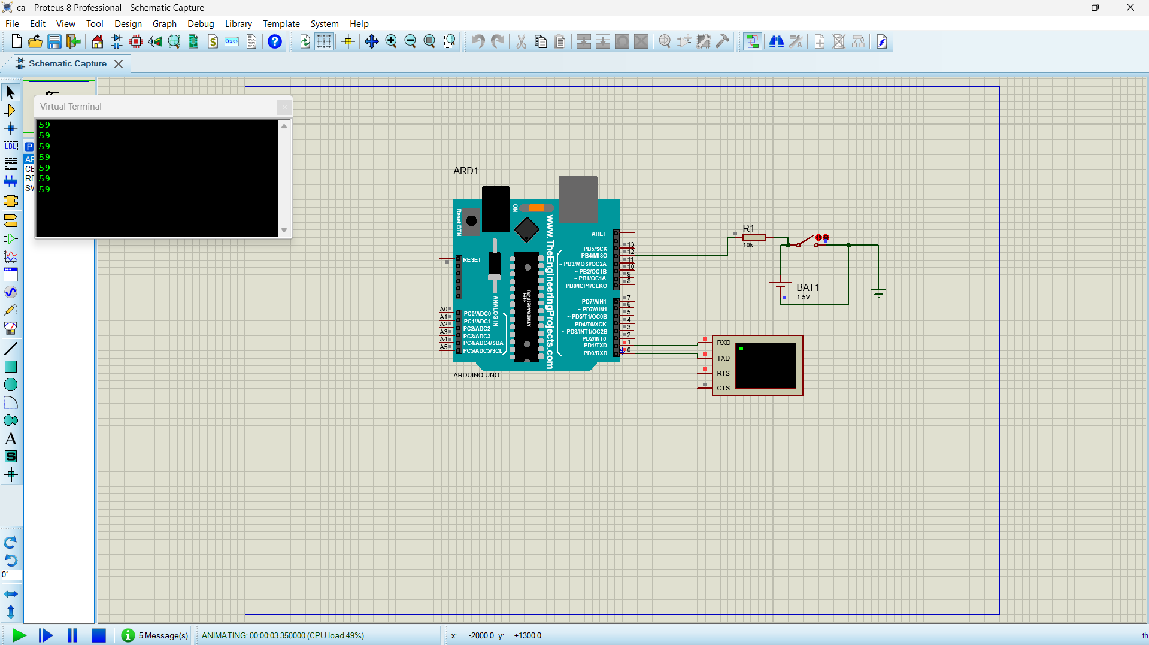

Slide 4
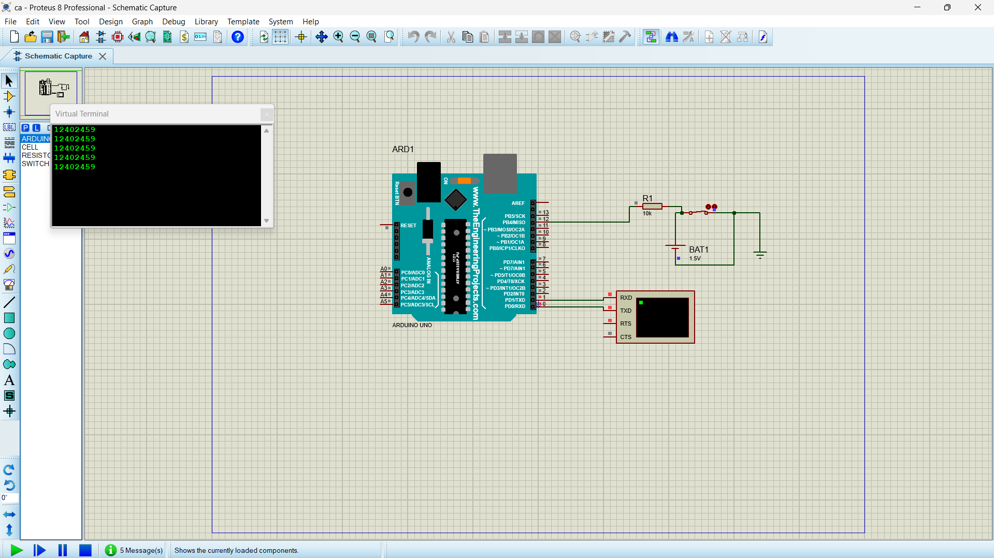

Slide 5
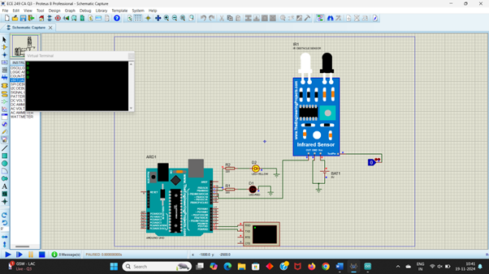
Question no 3

Slide 6
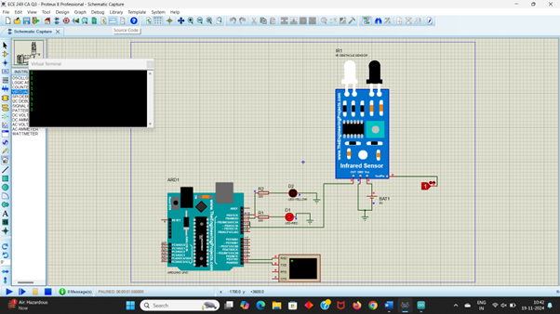

Slide 7
